Slide 1

API Project: Dungeons & Dragons Monster Finder
Bailey Behning
Ben Martin
Nick Mullenmeister
Grant Royseth

Slide 2
“The worthy GM never purposely kills players’ PCs, He presents opportunities for the rash and unthinking players to do that all on their own.”
- Gary Gygax

Slide 3
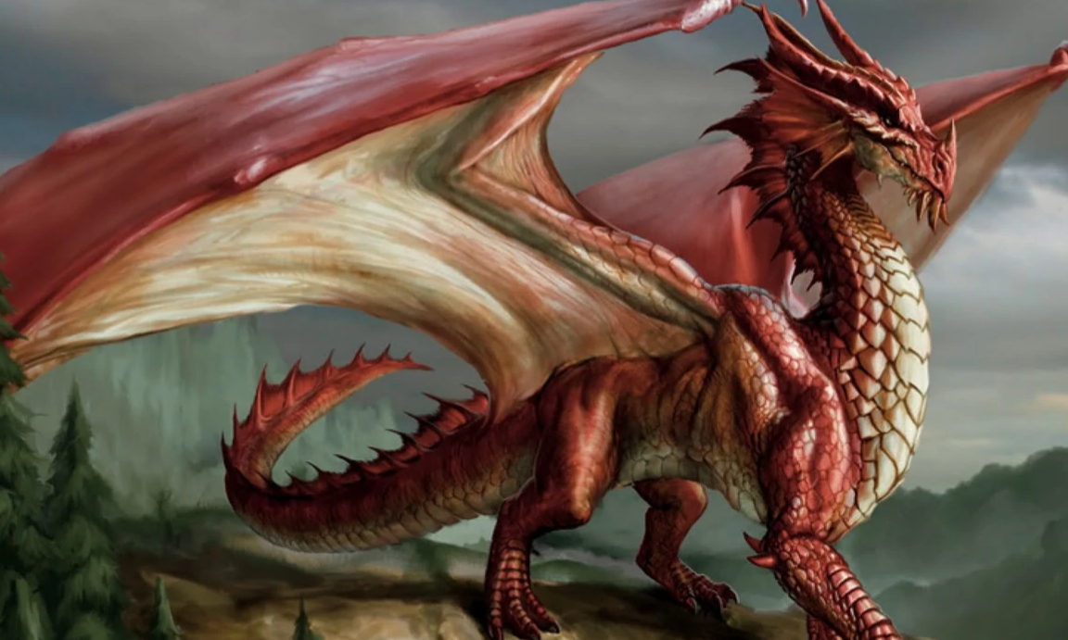
Finding the Right Monster for the Right Job
An encounter isn’t an encounter without monsters.
But as more books are added, finding the monster you’re looking for becomes hard!
What do???

Slide 4
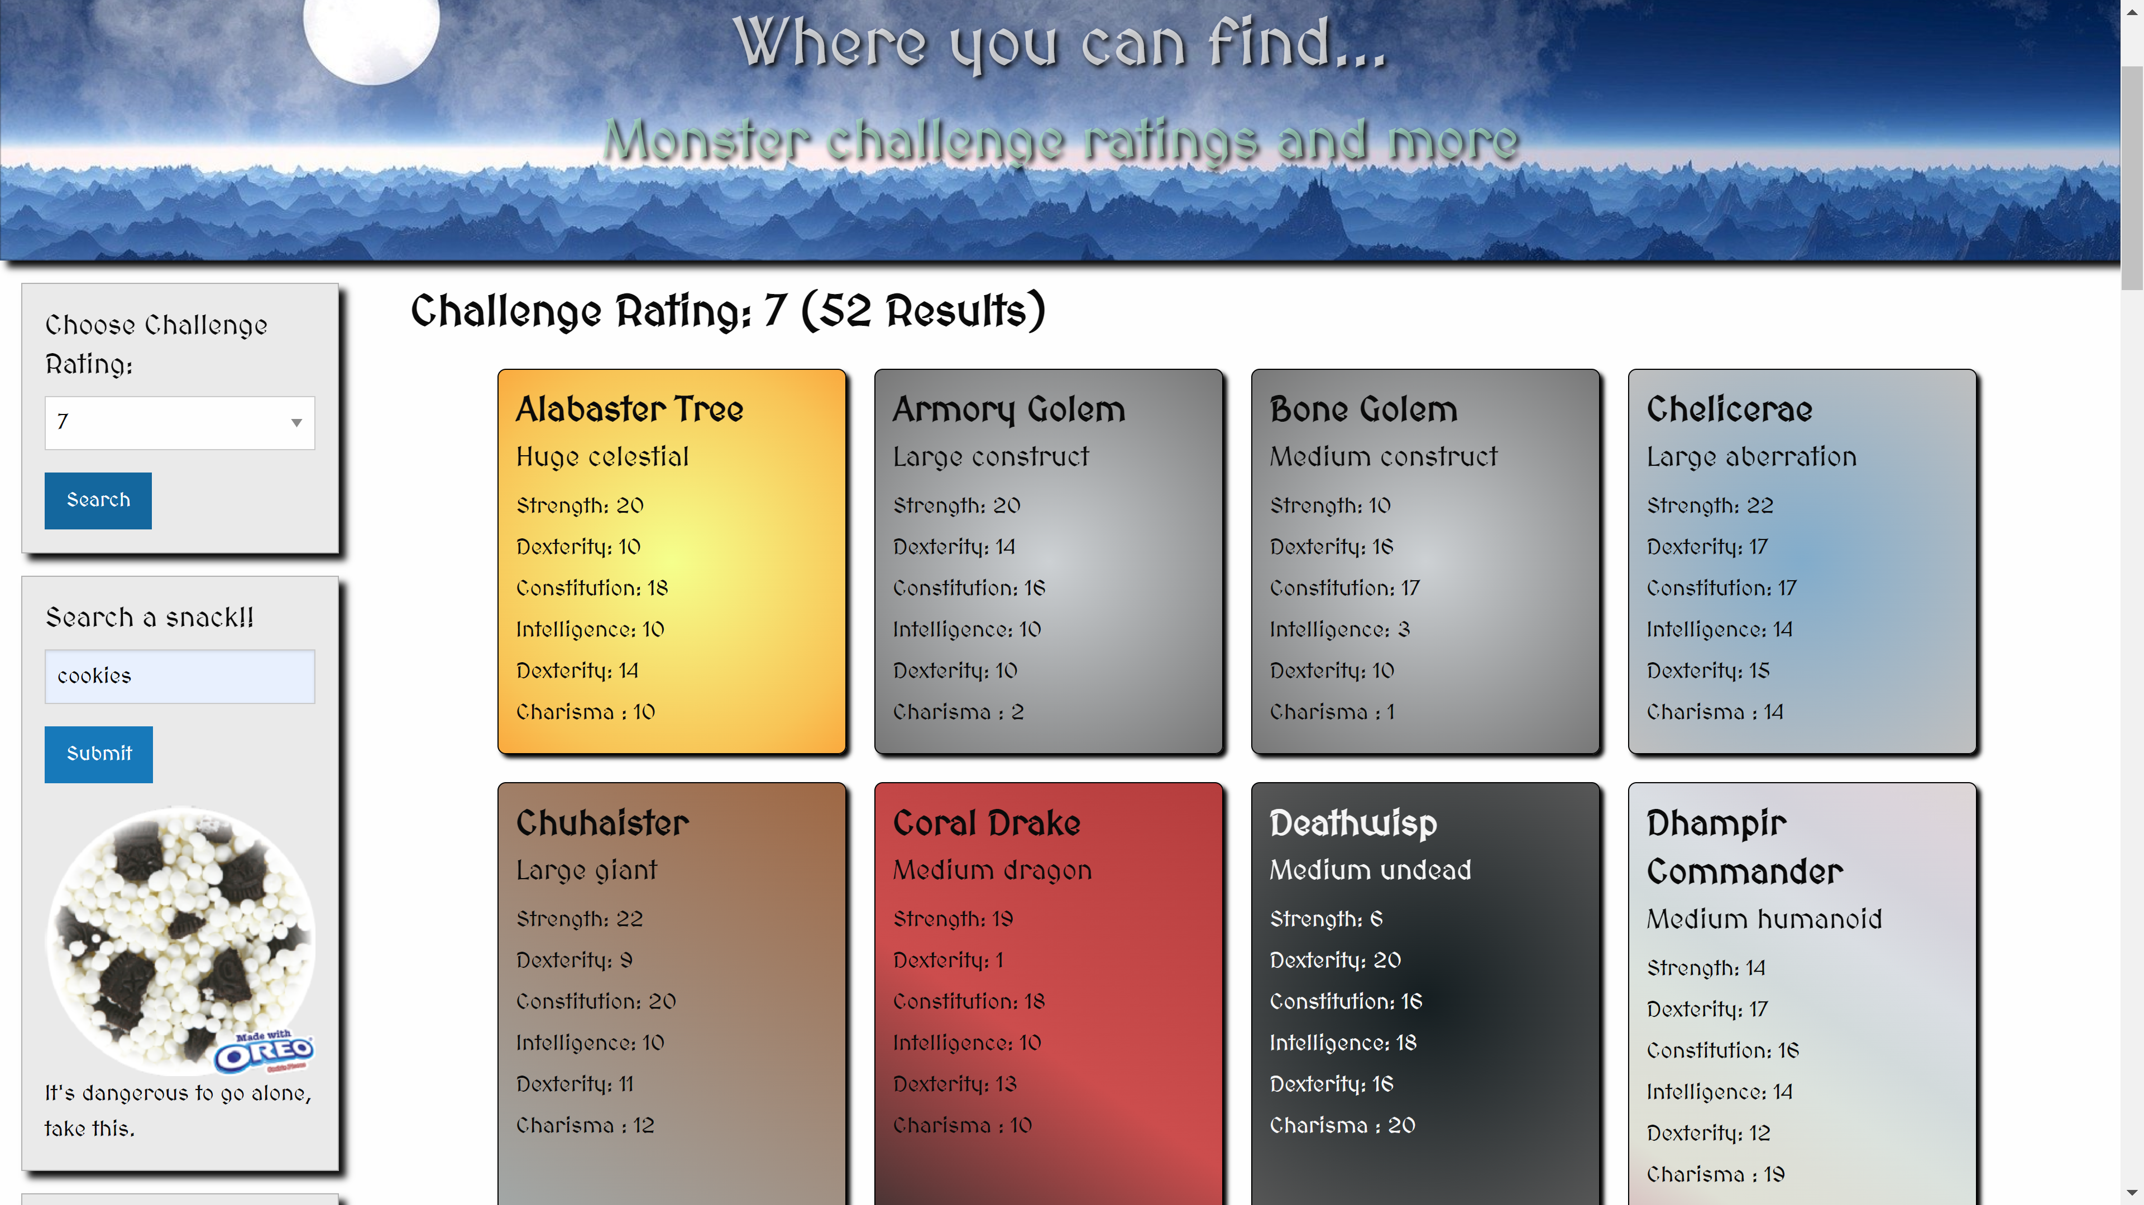
Introducing the Monster Finder!

Slide 5
Challenges
How do we get the right classes onto monster cards?
How do we store that data when it goes into local storage?
What do we do when the number of results exceeds the maximum number of items returned by the API?

Slide 6
Let’s check out the website!

Slide 7
Future Developments
Display a monster’s card when hovered from the saved list
Append cards with a button to see the monster’s full stats (probably in a modal)
Add more search parameters, such as the ability to choose what sourcebooks are returned.

Slide 8
“Games give you a chance to excel, and if you’re playing in good company you don’t even mind if you lose because you had the enjoyment of the company during the course of the game.”
- Gary Gygax

